Slide 1
Software Design
Hossam Adel

Slide 2




Who’s your instructor !
Hossam Adel (+7 year of Experience )
Graduated 2011 ( Benha University )
Master Degree in Embedded System
IST Industries (2 year) - CAI, EGY
Avelabs (2 year) – CAI, EGY
Thirdwayv (1 year) – CAI, EGY
Delphi Technologies (+1 year) – MI, USA
Freelancer Instructor Resala, AMIT, ITI, eCore and Sprints (+5 year)

Slide 3

Agenda
Introduction
Static Design
Dynamic Design
TMU (Timer Magnt Unit)
BCM (Basic Com Module)
Small OS
Application Design using RTOS
References
Q&A

Slide 4
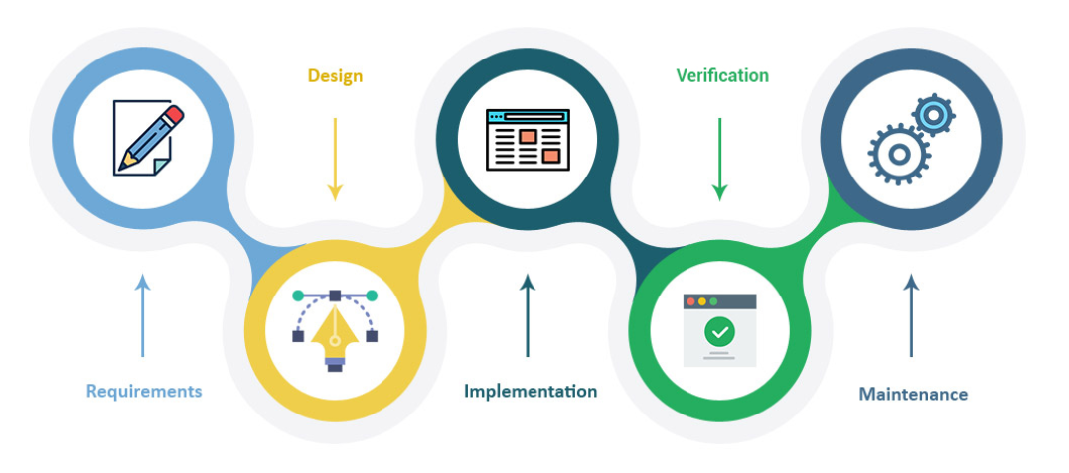
Introduction
SW Design
Software design is the process of envisioning and defining software solutions to one or more sets of problems. One of the main components of software design is the software requirements analysis (SRA).
Design Specs
Compatibility (backward-compatible)
Extendibility (add new code)
Modularity
Maintainability (easy for debug)
Reusability
Robustness (work hard)
Usability (user interface)
Scalability (increase input data)

Slide 5
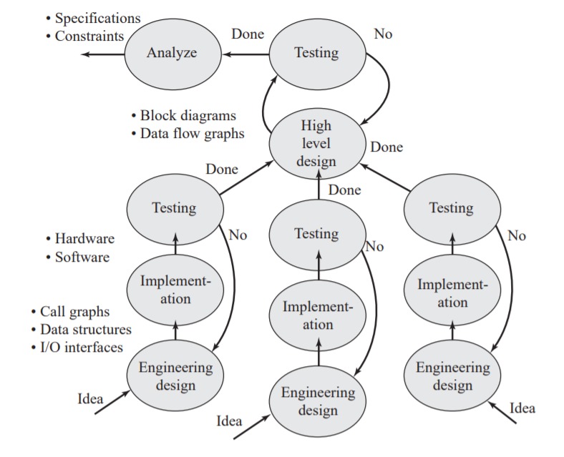
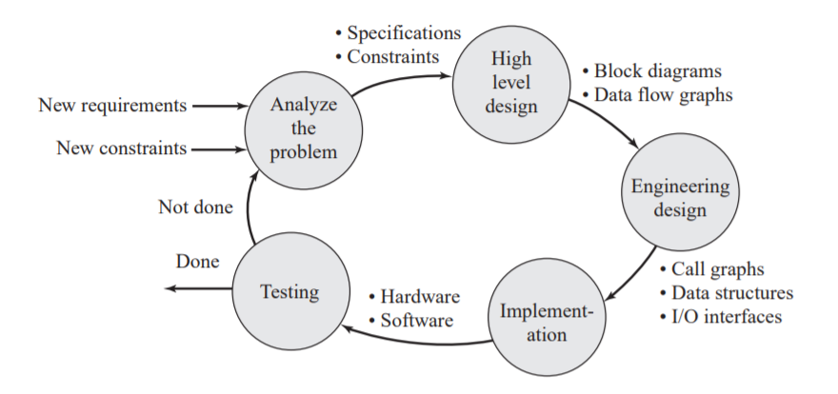
Software Design
Bottom Up Design Top-Down Design

Slide 6
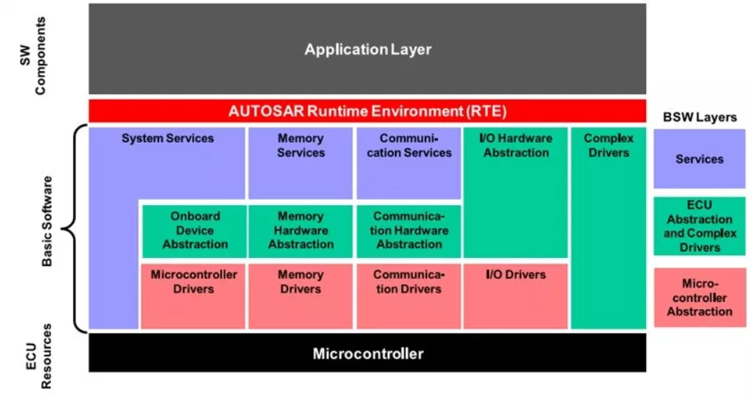
Static Design (software architecture)
Static Design have an answer for ..
What are the layers we have ?
Where’s the module allocate ?

Slide 7

Dynamic Design
Dynamic Design always answer how the modules talk with each other !

Slide 8
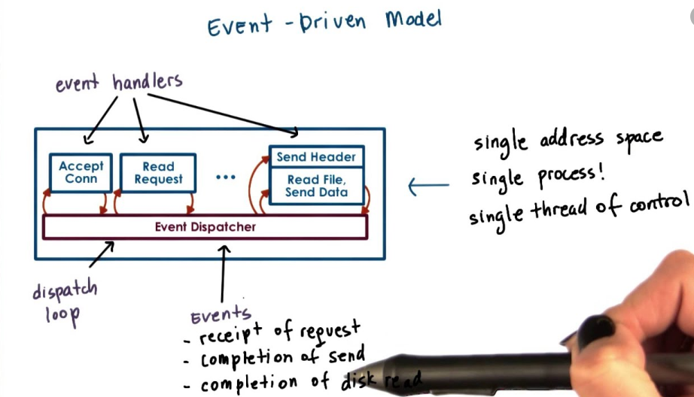
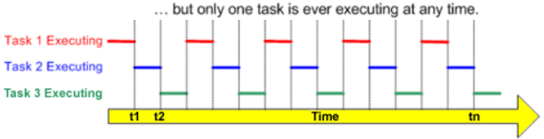
Dynamic Design
Super Loop Design
Event driven
Interrupt base Design
Event base Design
RTOS Design
Timing base Design

Slide 9
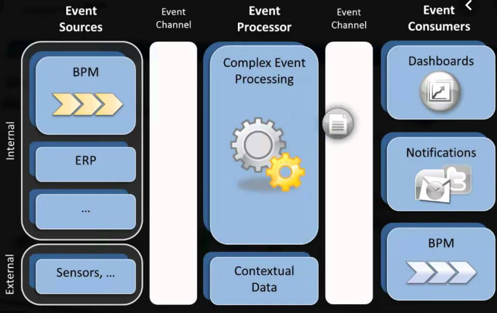
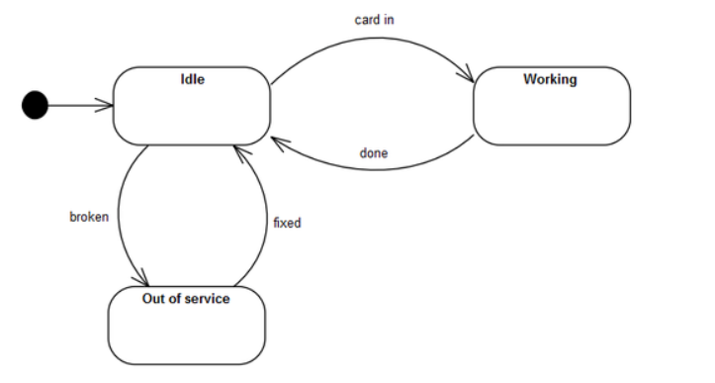
Event Driven Design (EDA)
Event Creator
Event Manager
Event Consumer
Sequence Diagram.
Finite state machine.

Slide 10
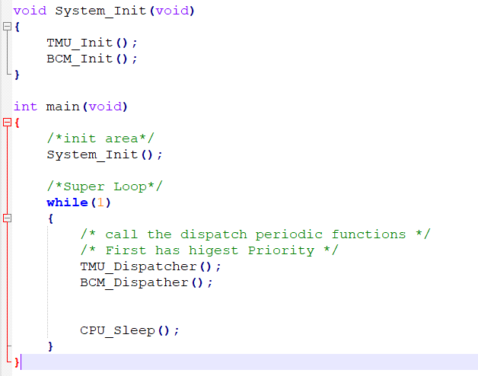
Super Loop Design

Slide 11

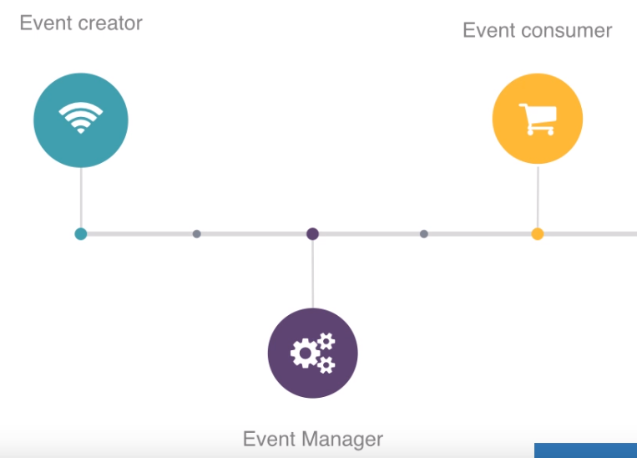
TMU (Timer Management Unit)
TMU_Init
TMU_Dispatcher
TMU_Start_Time
TMU_Stop_Time
TMU_DeInit

Slide 12
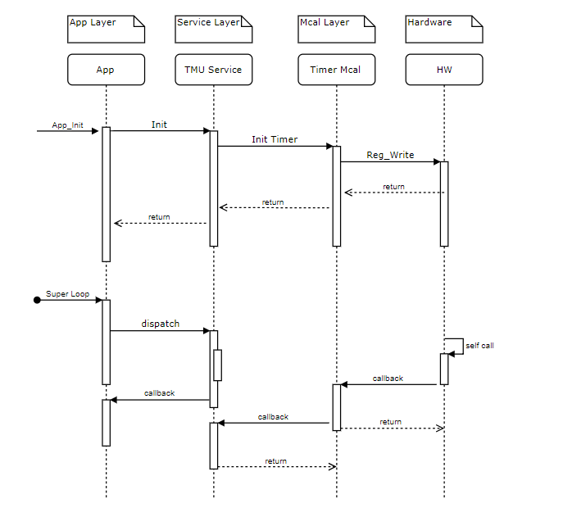
TMU (Timer Management Unit)

Slide 13

BCM (Basic Com Module )
How to send 1000 byte ?
Draw the Sequence Diagram !

Slide 14
BCM (Basic Com Module )
BCM_Init
BCM_Send
BCM_Setup_Receive
BCM_RxDispatcher
BCM_TxDispatcher
BCM_RxUnlock
Packet [Command - Size – Data – CS ]

Slide 15
CPU Load
How to calculate the CPU utilization ?! In Super Loop Design Mechanism.
Assume we have two Dispatcher functions (TMU and BCM).
CPU Load = ??
Twdg = ??

Slide 16
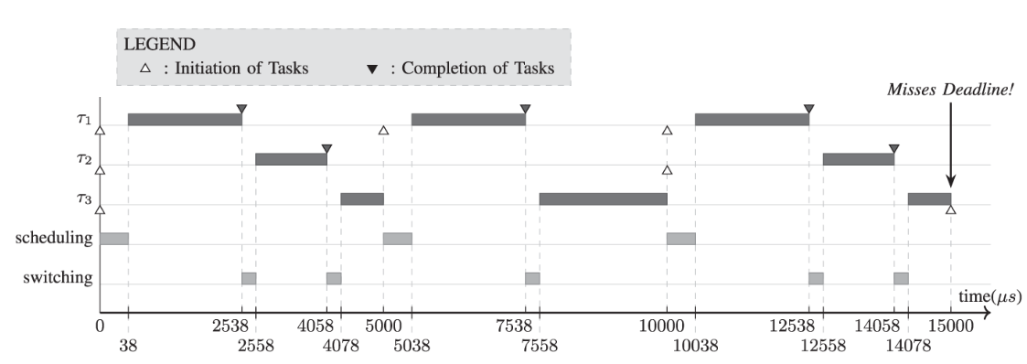
OS Design
Why we use OS ?!
Where should OS be in the SW architecture ?
Is the OS adding system overhead !

Slide 17
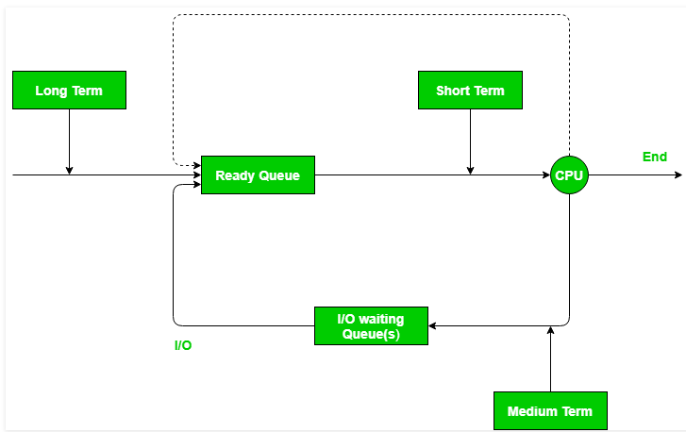
Dispatcher VS Scheduler
Schedulers are special system software which handle process scheduling in various ways. Their main task is to select the jobs to be submitted into the system and to decide which process to run. There are three parts (Long, Medium and Short term ).
Dispatcher is a special program which comes into play after the scheduler. When the scheduler completes its job of selecting a process, it is the dispatcher which takes that process to the desired state/queue. The dispatcher is the module that gives a process control over the CPU after it has been selected by the short-term scheduler. This function involves the following:
Switching context
Switching to user mode
Jumping to the proper location in the user program to restart that program

Slide 18
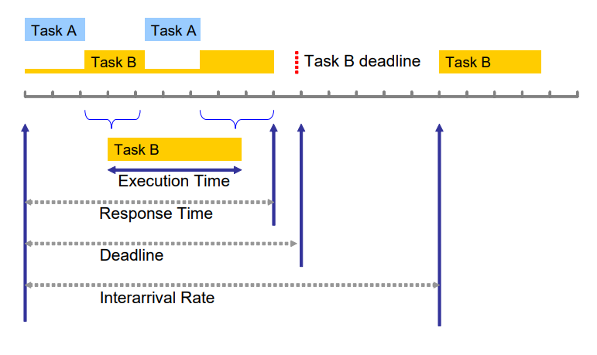
Small OS Design
Sos_Init
Sos_Run
Sos_Create_Task
Sos_Delete_Task
Task Design and Draw the Sequence Diagram ! ☺

Slide 19
Application Design Using RTOS

Slide 20

Design Tasks
Architect need to decide :
N: number of tasks in the system
C : Task Capacity (ExcTime)
T: Task periodicity
P: Task Priority
Ttick : System tick
Twdg : Wdg Timer period

Slide 21
RMS (Rate-monotonic scheduling)
is a priority assignment algorithm used in real-time operating systems (RTOS) with a static-priority scheduling class.
The static priorities are assigned according to the cycle duration of the job, so a shorter cycle duration results in a higher job priority.

Slide 22
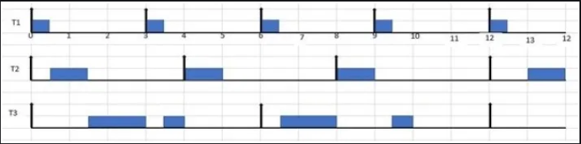
RMS (Rate-monotonic scheduling)
Ti (Pi , Ci) P : Period , C : Capacity (Processing Time )
T1 (3 , 0.5) - Highest
T2 (4 , 1) - Medium
T3 (6 , 2) - Lowest

Slide 23
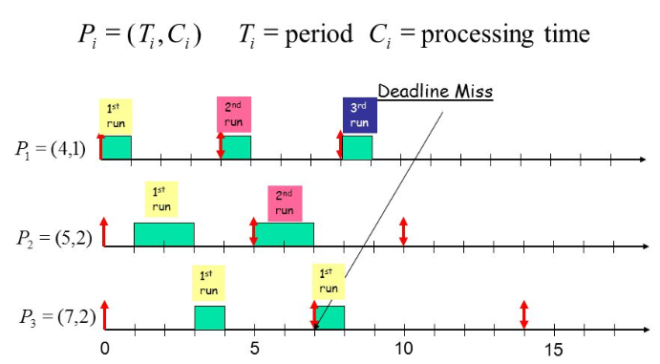
RMS (Rate-monotonic scheduling)

Slide 24
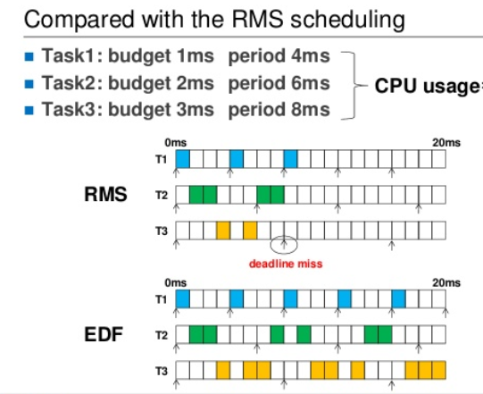
RMS vs EDL

Slide 25


RMS (Rate-monotonic scheduling)
Liu & Layland (1973) proved that for a set of n periodic tasks with unique periods, a feasible schedule that will always meet deadlines exists if the CPU utilization is below a specific bound (depending on the number of tasks). The schedulable test for RMS is:
U : CPU Utilization
C: Task Capacity
T: Task Periodicity
N : Number of tasks

Slide 26
References
Use https://www.draw.io/ to draw the sequence Diagram
http://s1.nonlinear.ir/epublish/book/Embedded_Microcomputer_Systems_Real_Time_Interfacing_1111426252.pdf
https://pdfs.semanticscholar.org/a312/430dc5a54a1cae78e19f06c3ffa8509015a7.pdf
https://en.wikipedia.org/wiki/Rate-monotonic_scheduling

Slide 27
THANK YOU
Hossam Adel

